Slide 1
Topic 4 (continued) Schema Mapping Conceptual to Relational Schema
Ir. Endang Ripmiatin, MT
Program Studi Teknik Informatika
Universitas Al Azhar Indonesia
October 2017

Slide 2
Reduction of an E-R Schema to Tables
Primary keys allow entity sets and relationship sets to be expressed uniformly as tables which represent the contents of the database.
A database which conforms to an E-R diagram can be represented by a collection of tables.
For each entity set and relationship set there is a unique table which is assigned the name of the corresponding entity set or relationship set.
Each table has a number of columns (generally corresponding to attributes), which have unique names.
Converting an E-R diagram to a table format is the basis for deriving a relational database design from an E-R diagram.

Slide 3
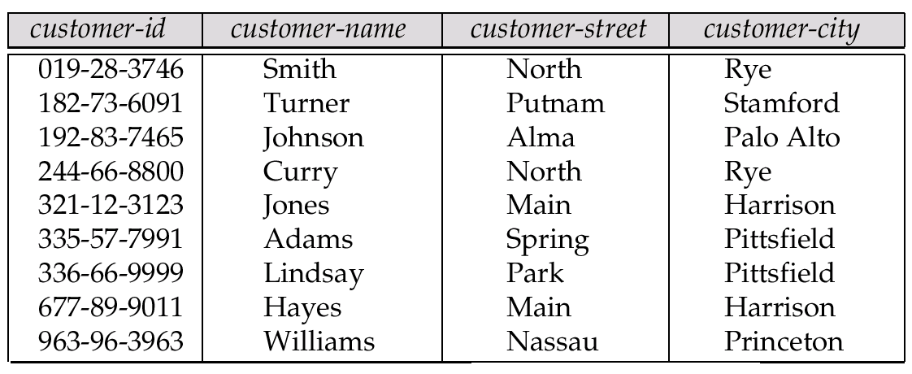
Representing Entity Sets as Tables
A strong entity set reduces to a table with the same attributes.

Slide 4
Composite and Multivalued Attributes
Composite attributes are flattened out by creating a separate attribute for each component attribute
E.g. given entity set customer with composite attribute name with component attributes first-name and last-name the table corresponding to the entity set has two attributes name.first-name and name.last-name
A multivalued attribute M of an entity E is represented by a separate table EM
Table EM has attributes corresponding to the primary key of E and an attribute corresponding to multivalued attribute M
E.g. Multivalued attribute dependent-names of employee is represented by a table employee-dependent-names( employee-id, dname)
Each value of the multivalued attribute maps to a separate row of the table EM
E.g., an employee entity with primary key John and dependents Johnson and Johndotir maps to two rows: (John, Johnson) and (John, Johndotir)

Slide 5
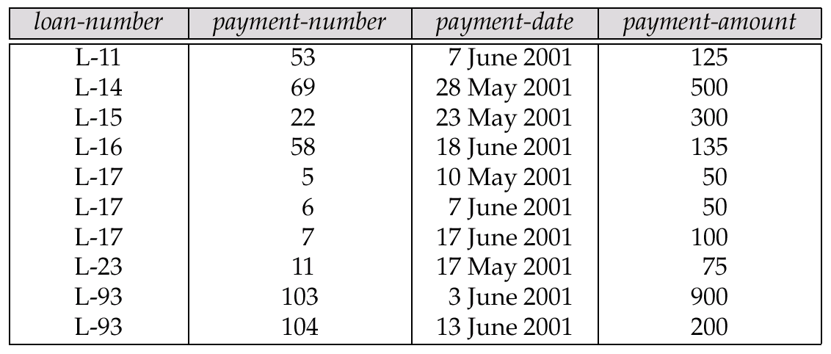
Representing Weak Entity Sets
A weak entity set becomes a table that includes a column for the primary key of the identifying strong entity set

Slide 6
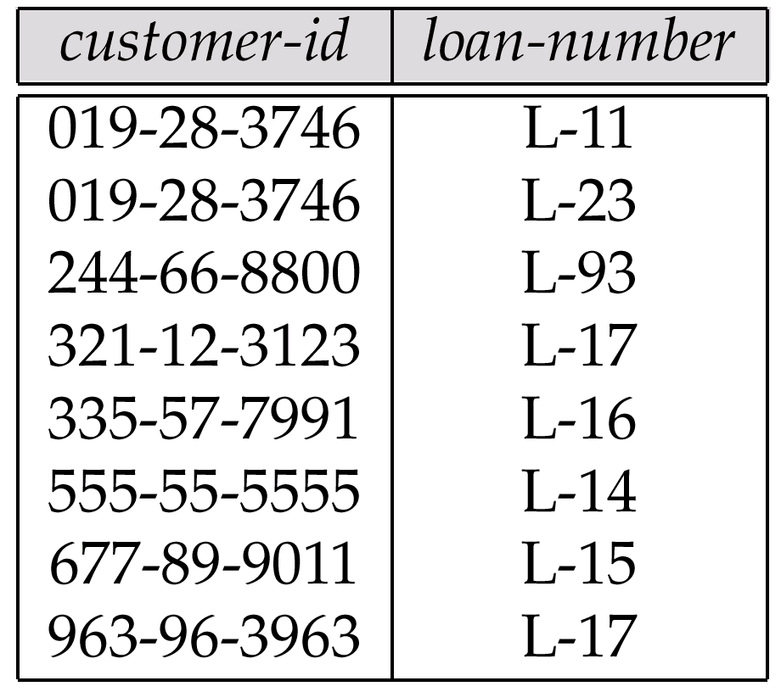
Representing Relationship Sets as Tables
A many-to-many relationship set is represented as a table with columns for the primary keys of the two participating entity sets, and any descriptive attributes of the relationship set.
E.g.: table for relationship set borrower

Slide 7
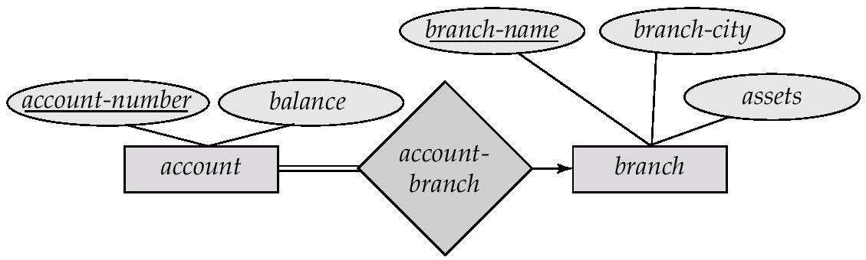
Redundancy of Tables
Many-to-one and one-to-many relationship sets that are total on the many-side can be represented by adding an extra attribute to the many side, containing the primary key of the one side
E.g.: Instead of creating a table for relationship account-branch, add an attribute branch to the entity set account

Slide 8
Redundancy of Tables (Cont.)
For one-to-one relationship sets, either side can be chosen to act as the “many” side
That is, extra attribute can be added to either of the tables corresponding to the two entity sets
If participation is partial on the many side, replacing a table by an extra attribute in the relation corresponding to the “many” side could result in null values
The table corresponding to a relationship set linking a weak entity set to its identifying strong entity set is redundant.
E.g. The payment table already contains the information that would appear in the loan-payment table (i.e., the columns loan-number and payment-number).

Slide 9
Representing Specialization as Tables
Method 1:
Form a table for the higher level entity
Form a table for each lower level entity set, include primary key of higher level entity set and local attributes table table attributes person name, street, city customer name, credit-rating employee name, salary
Drawback: getting information about, e.g., employee requires accessing two tables

Slide 10
Representing Specialization as Tables (Cont.)
Method 2:
Form a table for each entity set with all local and inherited attributes table table attributes person name, street, city customer name, street, city, credit-rating employee name, street, city, salary
If specialization is total, table for generalized entity (person) not required to store information
Can be defined as a “view” relation containing union of specialization tables
But explicit table may still be needed for foreign key constraints
Drawback: street and city may be stored redundantly for persons who are both customers and employees

Slide 11
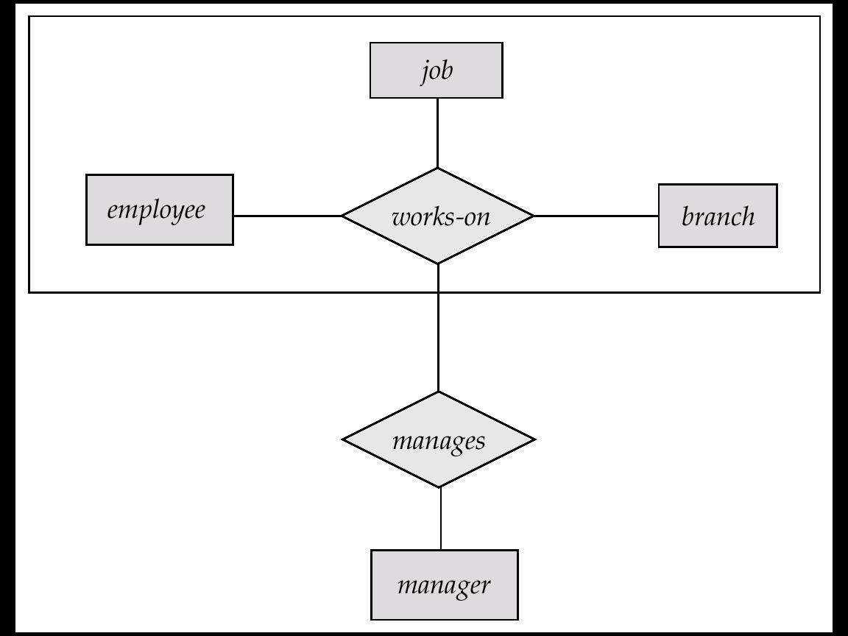
Relations Corresponding to Aggregation
To represent aggregation, create a table containing
primary key of the aggregated relationship,
the primary key of the associated entity set
Any descriptive attributes
E.g. to represent aggregation manages between relationship works-on and entity set manager, create a table manages(employee-id, branch-name, title, manager-name)
Table works-on is redundant provided we are willing to store null values for attribute manager-name in table manages

Slide 12
Existence Dependencies
If the existence of entity x depends on the existence of entity y, then x is said to be existence dependent on y.
y is a dominant entity (in example below, loan)
x is a subordinate entity (in example below, payment)
loan-payment
loan
payment
If a loan entity is deleted, then all its associated payment entities must be deleted also.

